Slide 1
SAP BTP Extension Suite Training
Day 3
Anubhav Oberoy
www.AnubhavTrainings.com
Follow excellence with sheer passion

Slide 2
Agenda – Day 3
01
04
SAP Fiori elements
Draft Functionality
02
05
Fiori Elements VS Free Style
Association v/s Composition
03
06
Creating a Fiori an to consume our service
Create F4 Enablement for app

Slide 3
Agenda – Day 3
07
10
What is Schema in HANA?
Git and Git HUB
08
11
Introduction to HANA Cloud
HDI Container
09
12
HANA Cloud v/s On-premise
HANA Cloud Integration

Slide 4
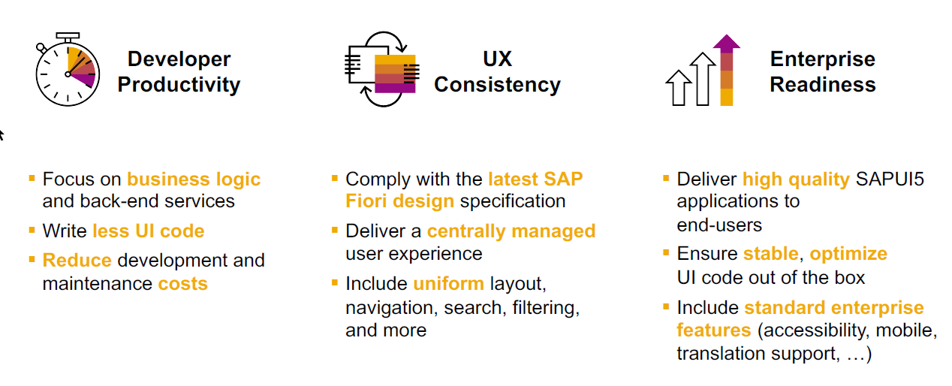
SAP Fiori elements boosts SAP Fiori development efficiency

Slide 5
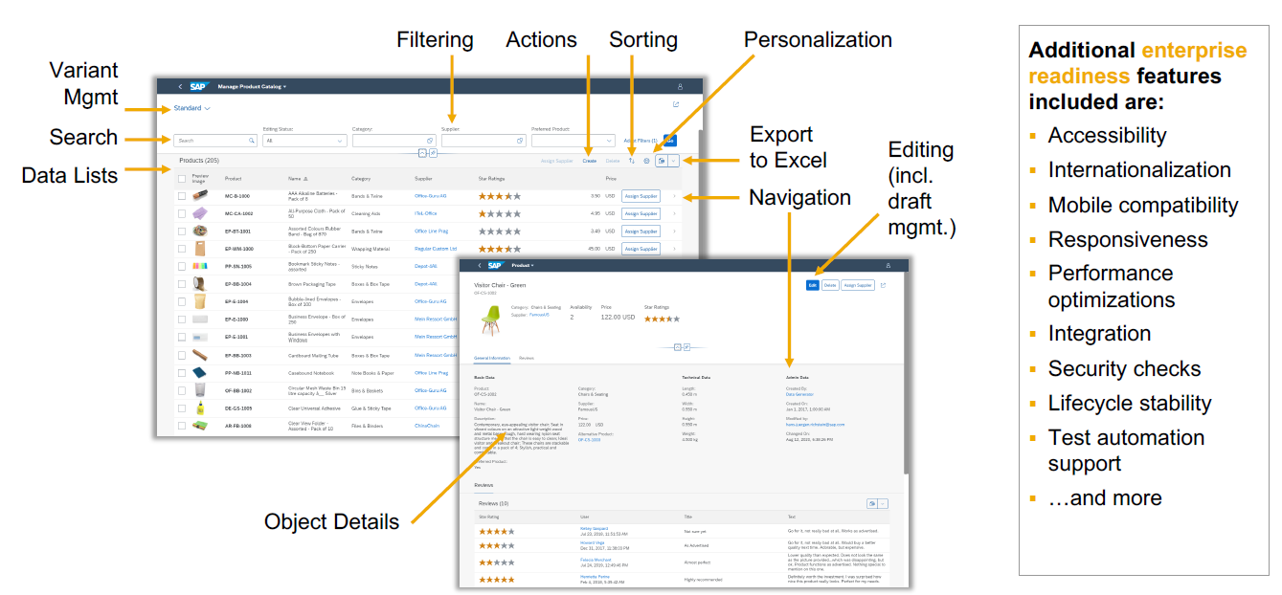
SAP Fiori elements provides enterprise-ready apps out of the box

Slide 6
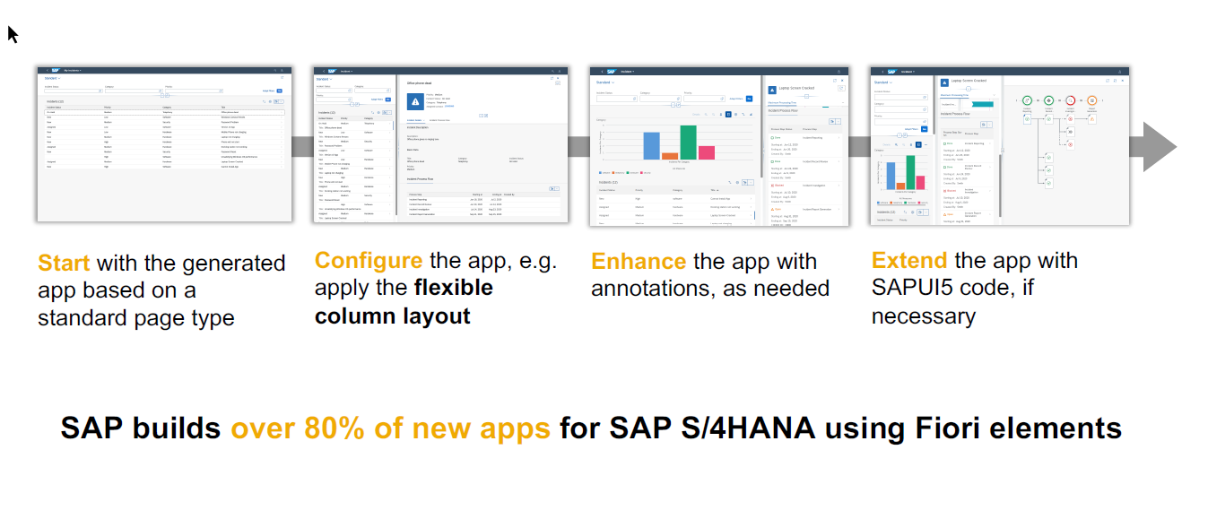
SAP Fiori elements application architecture provides flexibility

Slide 7
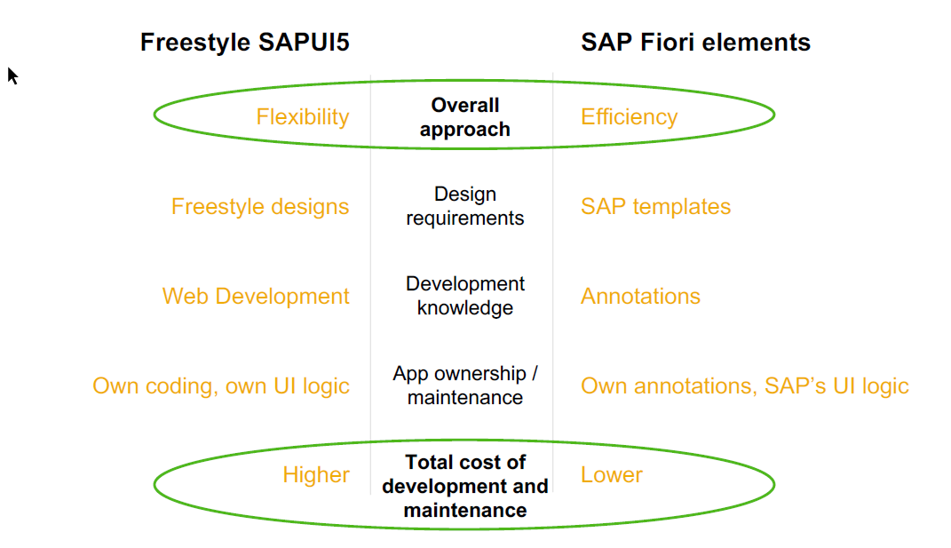
SAP Fiori elements prioritizes efficiency over flexibility

Slide 8

Hands on : Fiori App

Slide 9
Create Fiori App using Annotation
Exercise:
https://github.com/soyuztechnologies/SAP_BTP_Training_CLD200/blob/master/Day%203/03%20application/03application/app/purchaseorderapp/annotations.cds

Slide 10
Draft Functionality

Slide 11
Association v/s Composition
Association – a relationship between entities which is a lose coupling. Both objects should exist together. However, they can work independently. Airplane and passenger.
Composition – a relationship between entities which is a tight coupling. Both objects must exist together. They cannot function independently. Airplane and wings.
Purchase Order Header
composition
Purchase order Items

Slide 12

Hands on: Create & F4 Enablement for app
Solution: https://github.com/soyuztechnologies/SAP_BTP_Training_CLD200/tree/master/Day%204/capm%20draft%20and%20value%20helps

Slide 13
UI Improvements
Adding value helps
Fixing load of product data
Adding side effects for boost action
Debugging CAP App
Setting Default value
Adding custom actions on object page
Solution:
https://github.com/soyuztechnologies/SAP_BTP_Training_CLD200/blob/master/Day%206/New%20UI%20Changes%20and%20fixes.txt

Slide 14
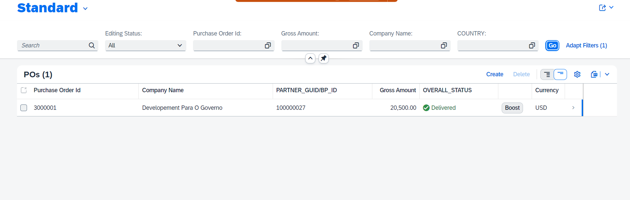



















Slide 15
Challenges to share code
Till now Anubhav is sharing zip file of project code with all of you, imagine in a team of 40 developers and at end of day if every developer share a zip file, who can merge all code.
When someone go on holiday or left team, how can we make sure that we have latest code available for successor to manage it.
Anubhav last evening my code was stable, this morning I came to office and made 40-50 changes which has disrupted everything, I pray to god to go back to last night state. Basically, we need version management.
In a team, one developer using BAS another using VS code another using WebIDE, how can we easily move code from one dev tool to another
When something cause production issues, we want to know which change was made by who last time that caused the issue.
How to share our code effectively between multiple team members as best practice from industry. And how to merge conflicts also.
Git and GitHub
Git is a de-central repository management system for managing any kind of source code. And git hub is a central repository where everyone sync their changes (internet).
https://git-scm.com/download/win

Slide 16
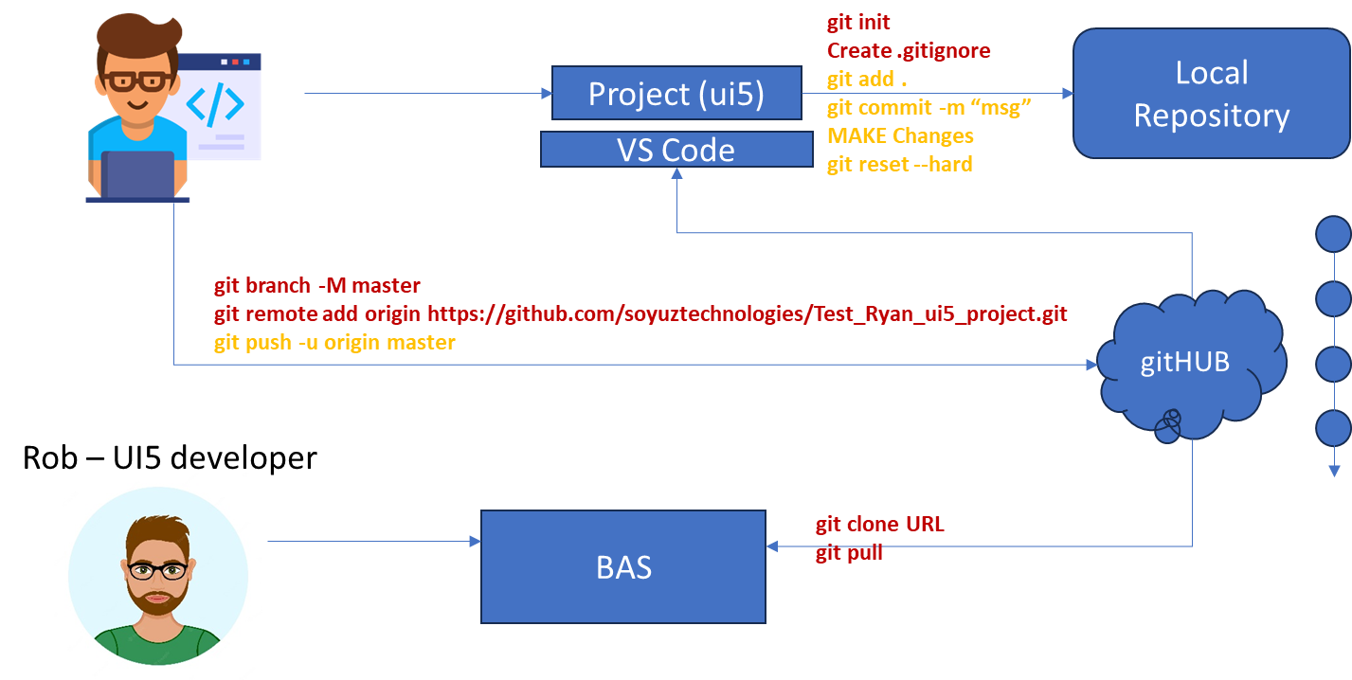
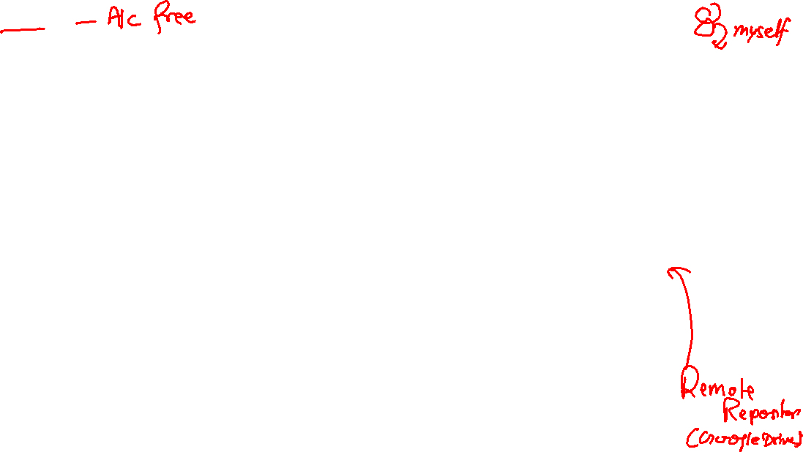
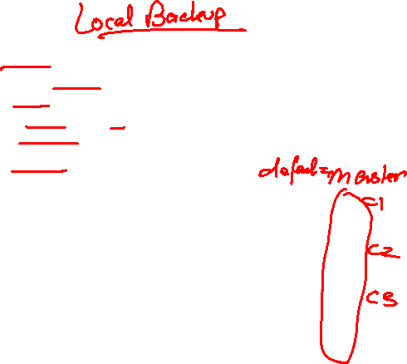
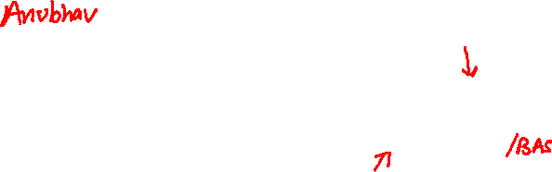
Git and Git HUB

Slide 17
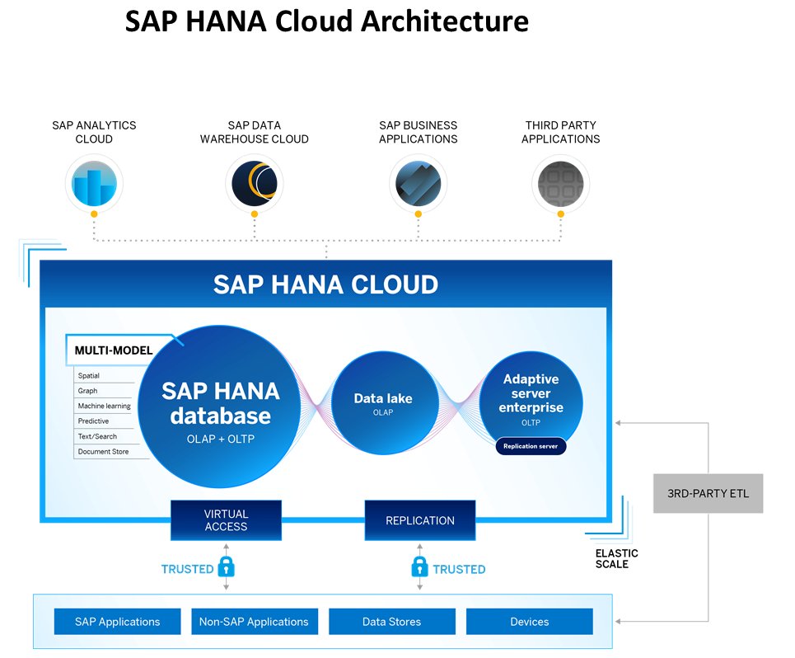
Introduction to HANA Cloud
SAP HANA Cloud is a fully managed, in-memory, cloud database as a service (DBaaS). It is the cloud-based data foundation for SAP Business Technology Platform. With SAP HANA Cloud you can create, run, and extend new and existing applications.
SAP HANA Cloud includes a number of software components. The core component is SAP HANA Database, but other components can be added at any time, such as a data lake.
Key Components of SAP HANA Cloud
There are four key components of SAP HANA Cloud:
SAP HANA Cloud, SAP HANA Database
In-memory database with built-in advanced analytics (spatial, graph, text, etc.)
SAP HANA Cloud, data lake
Store and query large data sets and most file types
SAP HANA Cloud, adaptive server enterprise
Support for extreme –performance transactional applications
SAP HANA Cloud, adaptive server enterprise replication
Bi-directional real time data replication across databases

Slide 18
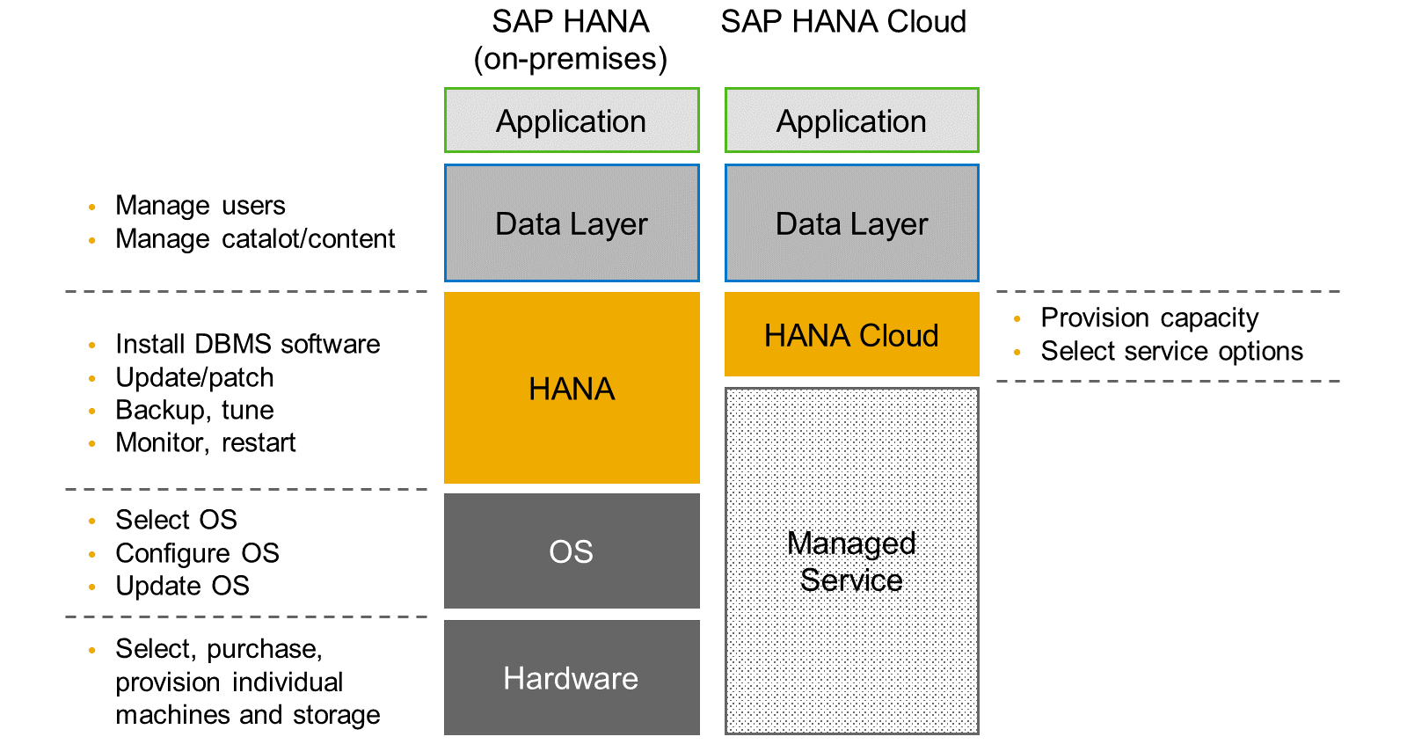
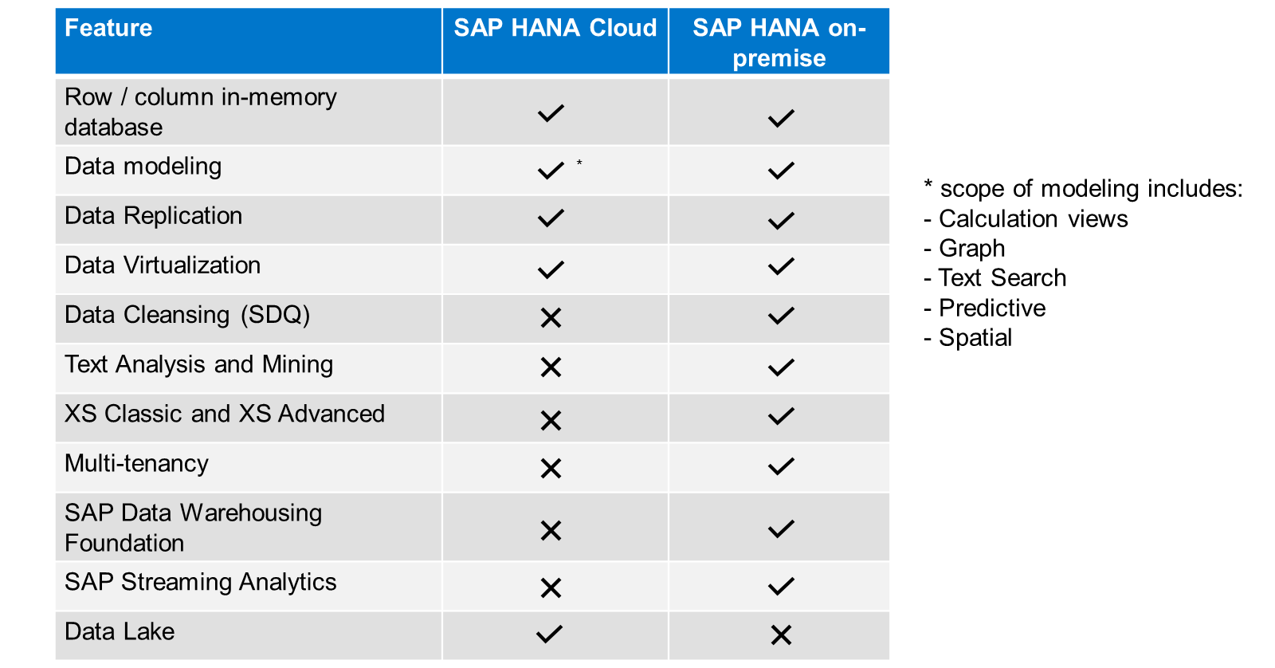
HANA Cloud v/s On-premise
Feature Differences
SAP HANA Cloud compares very closely with SAP HANA on-premise in terms of features but there are some differences.

Slide 19
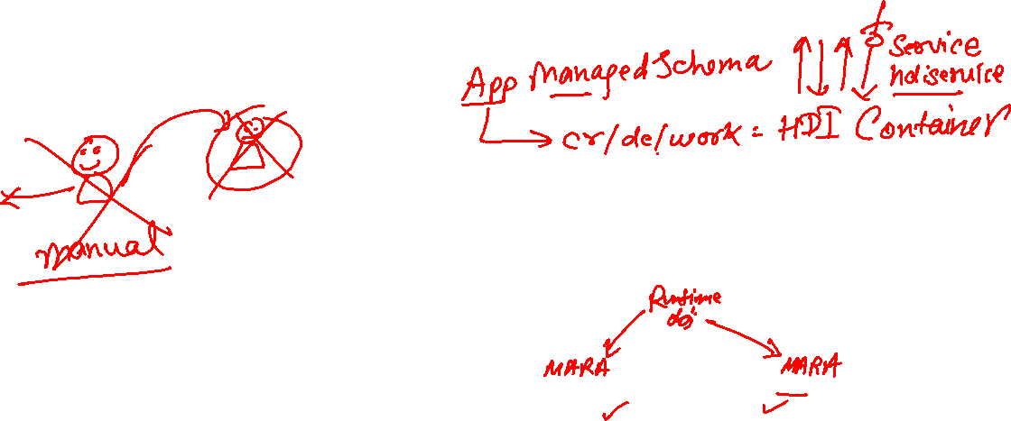
What is Schema in HANA
Schema – Is a mandatory database object of database which stores other database objects.
It’s a logical separation of database objects.
It is home of all the runtime object
Security
BW
ekko
ECC
ekko
S/4HANA
ekko
Non-SAP
SAP HANA 600GB
SCBW
ekko
ECC001
ekko
SAPS4C
ekko
MIG
ekko
SYS

Slide 20
HDI Container
An HDI Container is also a schema. But it is managed differently from a normal schema.
Schema -- How its created?
Manually create it in BTP
Application Managed HDI Container (You as developer ONLY work with App, App will talk to HANA to create and manage this schema to store/read data internally)
You cant access HDI Container using HANA Studio (Deprecated tool), We can use new SAP HANA Database Explorer, SAP HANA WebIDE for OP or BAS to access HDI Container.
HDI -- Who creates it?
There is a new service in SAP HANA called SAP HDI (HANA Deployer Infrastructure) which is just a microservice responsible to managing the container. HDI Deployer is a component which is used to talk to this service from our app.

Slide 21
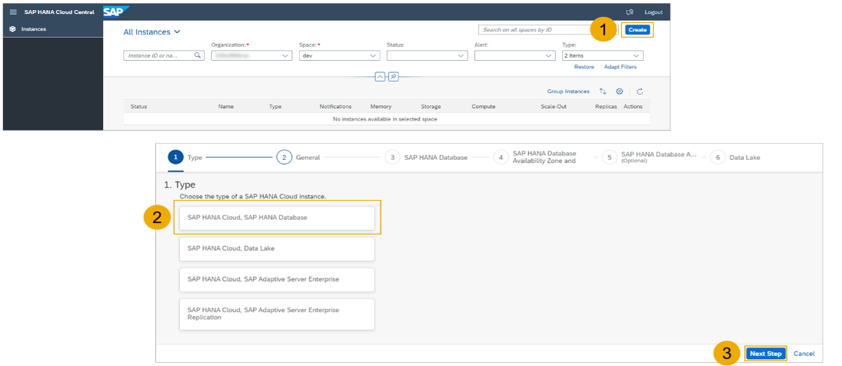
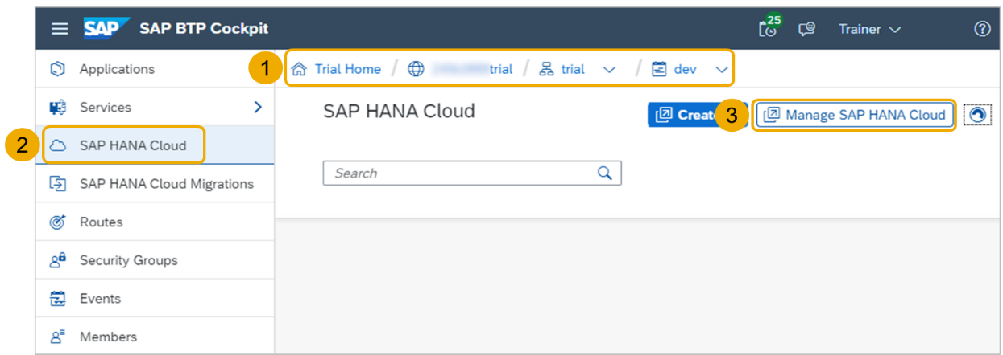
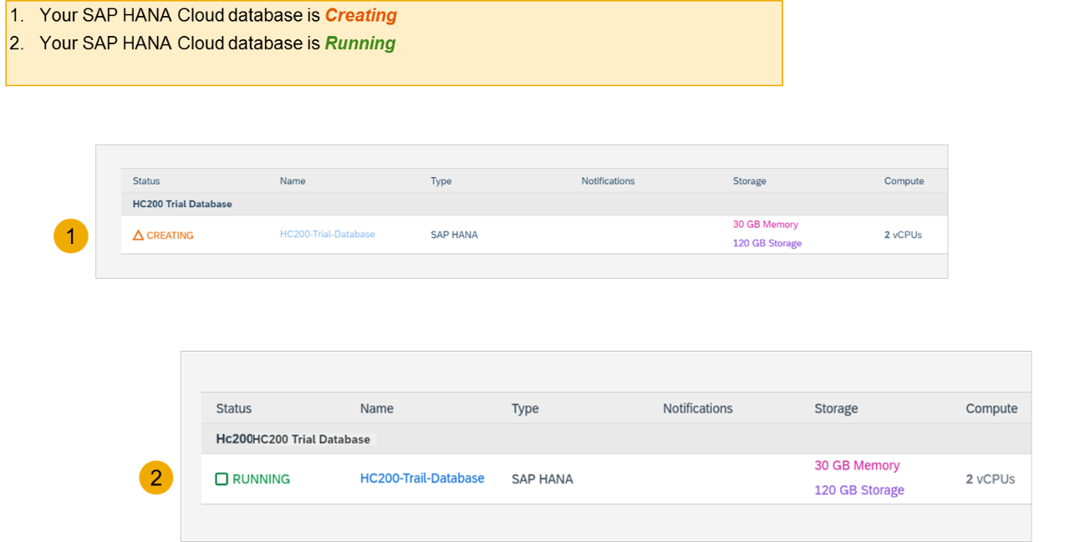
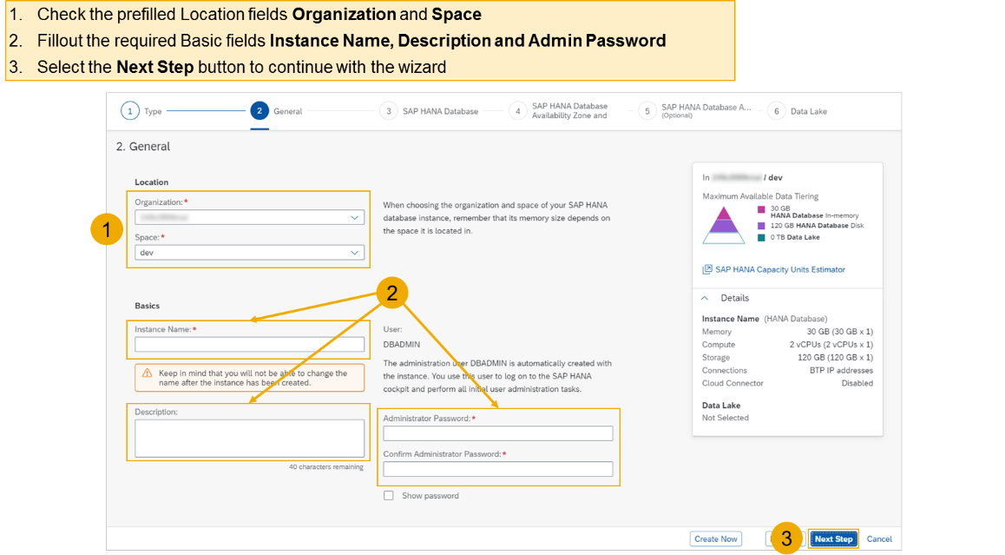
Hands on - Create HANA Cloud Instance
Login to your trial and navigate to your dev space
Select SAP HANA Cloud
Select the Manage SAP HANA Cloud button to start the SAP HANA Cloud Central
Select the Create button to start the wizard
Select the SAP HANA Cloud instance Type to create
Select the Next Step button to continue

Slide 22
Hands on – HANA Cloud Integration
Pre-requisites
Check the version of CDS (which must be > 2.0) cds –v
Start a HANA cloud instance in SAP BTP
Main steps
Add hana configuration to our app, which tell cap framework that the default db is now hana – cds add hana
2. Add the hana specific deployment format name to our project under cds section as below inside package.json file "hana":{
"deploy-format":"hdbtable"
}
3. Since the first step added the hdb node module, we need to install it. Run npm install
4. We need to perform a build, which will create all the hana specific files which will be deployed to HANA cloud. cds build --production
5. We need to login to cloud foundry from BAS – cf login
6. Finally we need to deploy the DB and everything to SAP HANA Cloud – cds deploy --to hana:batman
7. We fixed issues related to excel format of HANA and changed the size of field bankid for employee, redo the build and deploy
8. If deployment worked, a new file cdsrc-private.json gets created automatically, this file contain the information about which container in SAP BTP HANA Cloud to connect to. And the private key is stored in this file.
9. Provide the credentials which will be used to connect database, start using cds watch --profile hybrid
"credentials": {
"database": "batman-key"
}

Slide 23

What We Did
Let’s Summarize

Slide 24

www.anubhavtrainings.com
Thank You
End of Day 3

Slide 25



We’re committed to empower you to be
#FutureReady
through powerful training solutions.
We build the workforce of the future.
250+
Corporate Clients
30,000+
Learners Trained
25000+
Learners Placed
FREE WEBINARS
Sign up for free webinars with industry experts every fortnight!
Enroll Now!
Contact us today!
https://anubhavtrainings.com

